Slide 1
Reshape the Crowning Glory of Maasai Mara
MCM Team #2316192
Hanlin Cai (Fuzhou University)
Notes:
MCM-2316192美赛材料由 Hanlin Cai 汇总整理。材料完全免费开源，支持任意方式转载，必须注明来源。
如果你通过转售本材料获利，全部归你，但需要注意的是：销售行为与 Hanlin Cai 无关；如果你通过付费手段获得本材料，说明材料并非第一手转载，如果你注意到本声明，请勿再次二次售卖本材料，感谢理解支持！
倡导知识付费，是因为知识创建整理的过程复杂，需要付诸许多心血，而人的精力实在有限，知识付费让这一切关系变得健康；相反地，倡导知识开源，恰恰也正是因为知识宝贵，所以需要让更多人受益，从而充分发挥人的劳动价值——这是在计划里的捐献。
最后的最后，祝你考比赛顺利，学业有成。我们高处见。
MCM-2316192仓库：https://github.com/GuangLun2000/MCM-2316192

Slide 2
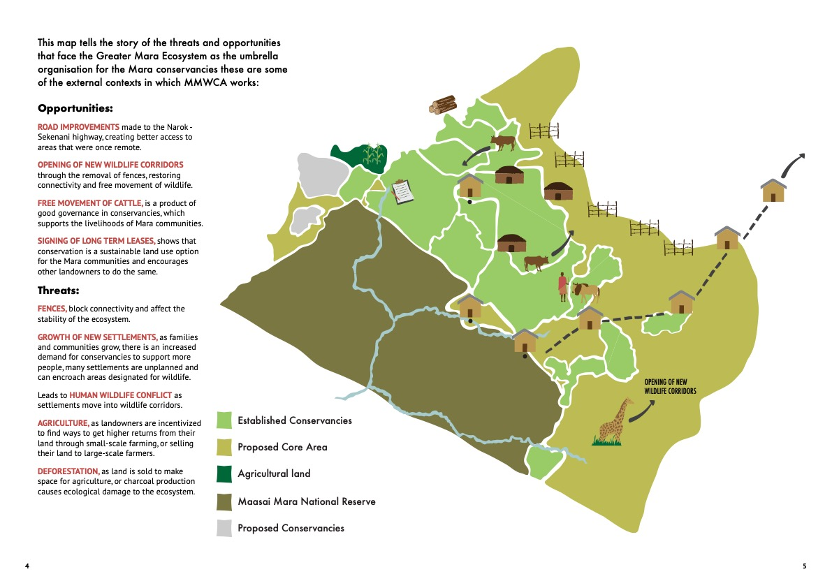

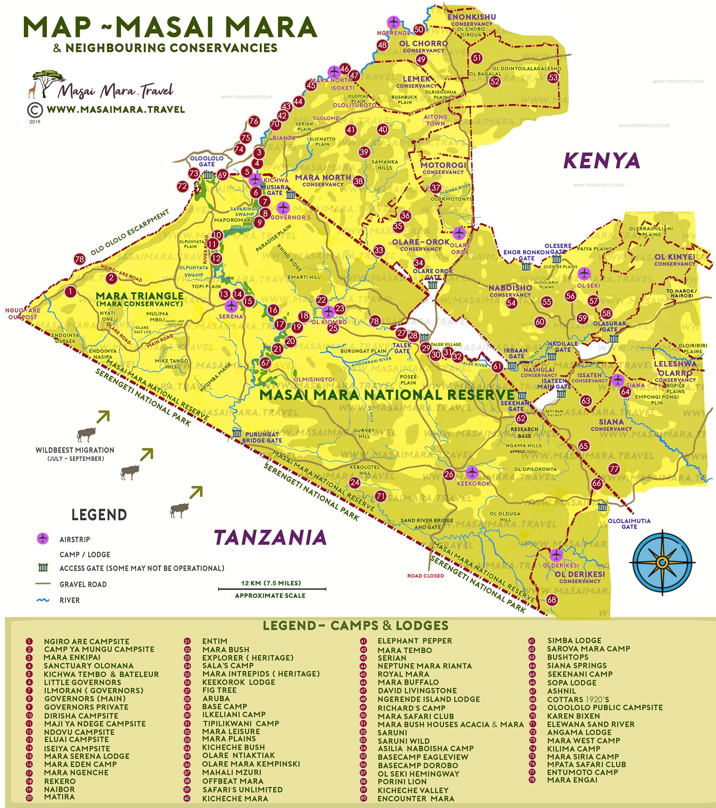

Figure 1 Template

Slide 3
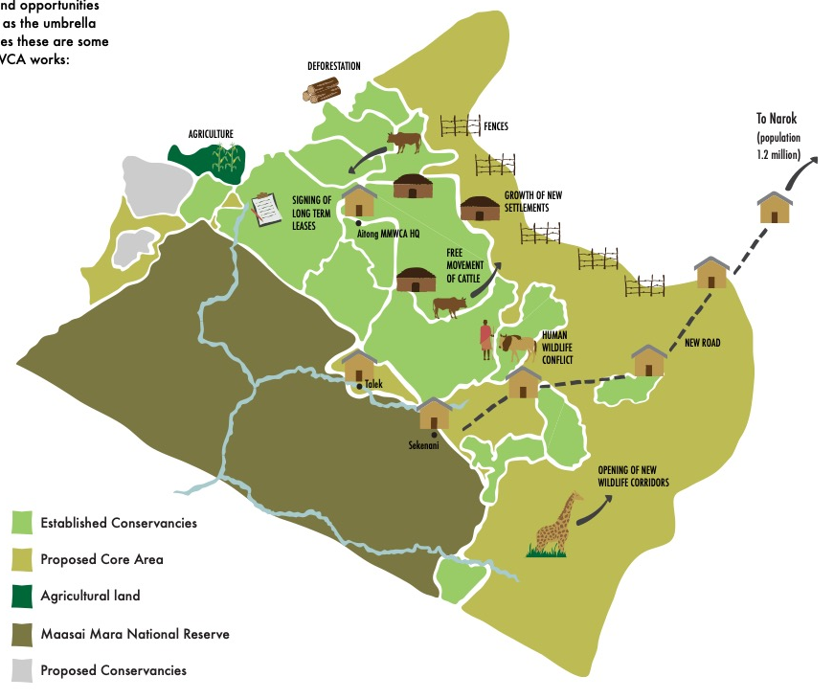
Figure 1 Template

Slide 4
Figure 1

Slide 5
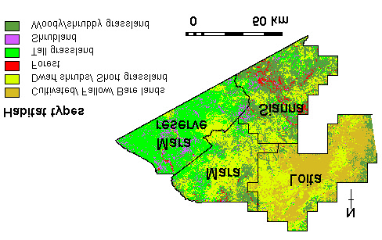
Figure 1 Reference

Slide 6
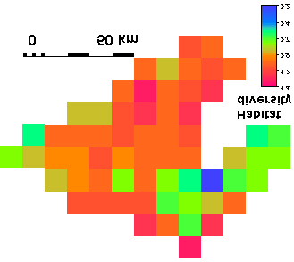
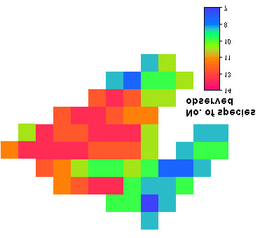
Figure 1 Reference

Slide 7
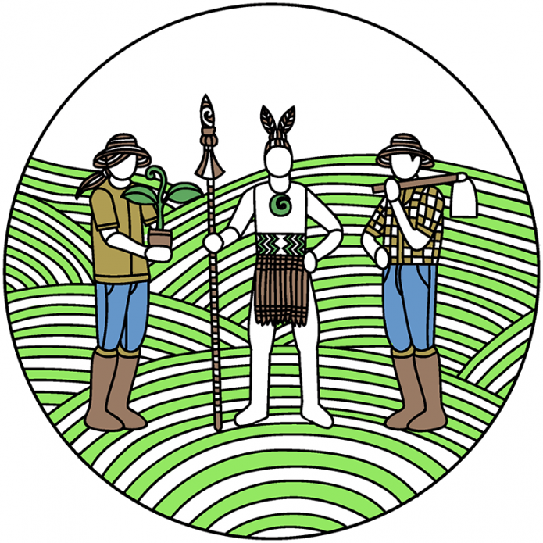

Maasai Mara
Human Society Subsystem
Coupling Area
Land Resource Subsystem
Human-Land
Figure 5

Slide 8
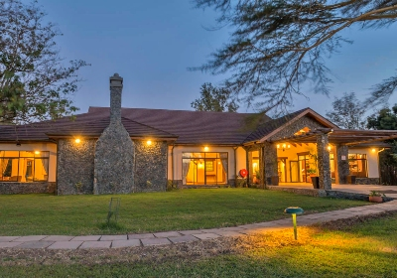
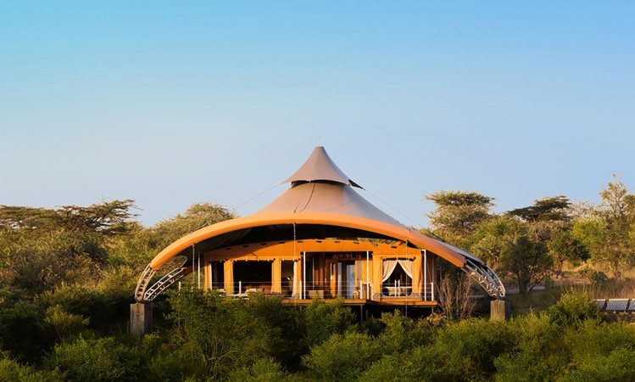
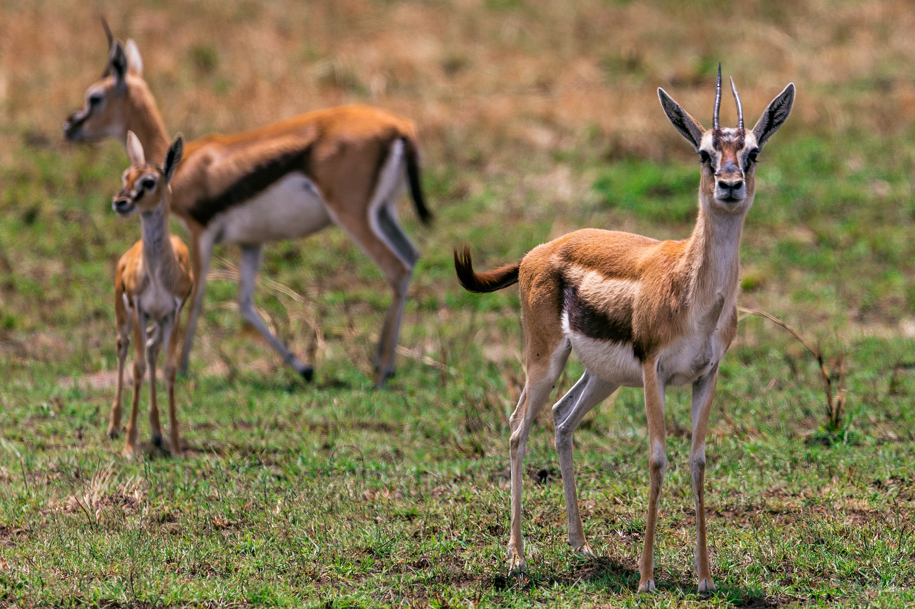
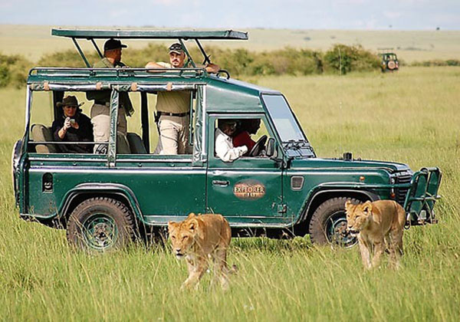




$$α_{4}=82.36°$$
$$α_{3}=56.25°$$
$$α_{1}=28.66°$$
$$α_{2}=41.19°$$
Figure 6*

Slide 9
$$0°≤α_{3}<25°$$
Undeveloped Area
Undeveloped Area
$$0°≤α_{4}<25°$$
$$0°≤α_{2}<25°$$
Undeveloped Area
Undeveloped Area
$$0°≤α_{1}<25°$$
Figure 6

Slide 10
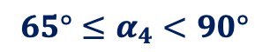



$$65°≤α_{4}<90°$$
$$45°≤α_{3}<65°$$
Overdeveloped Area
Coordinated Area
$$α_{4}$$
$$α_{3}$$
$$α_{1}$$
$$α_{2}$$
$$0°<α_{1}<35°$$
Underdeveloped Area
$$35°≤α_{2}<45°$$
Transitional Area
Figure 6

Slide 11
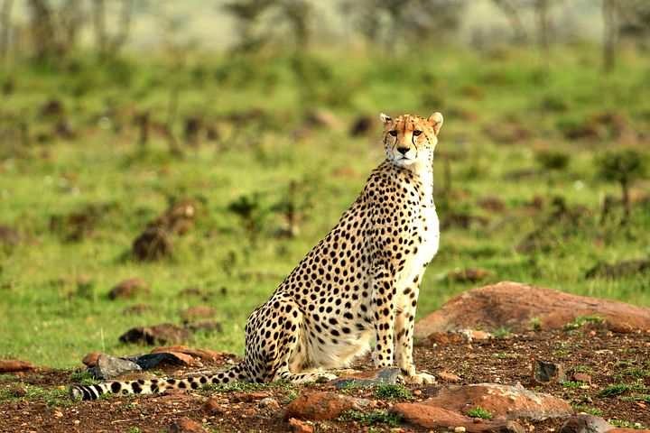




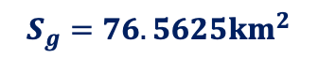
Mulima Mbili Area
$$α_{test}$$
$$α_{test}≈20°$$
$$1.5862S$$
$$34.370E$$
$$S_{g}=76.5625km^{2}$$
$$W_{g}≈8.75km^{2}$$
Type: Savannah
Figure 8

Slide 12
Figure 2*

Slide 13
Figure 2*

Slide 14
Training Dataset
Traffic Sign
ResNet-50
Training
RNN
Model
Image
Preprocess
80%
ResNet-101
ResNet-152
Dataset
20%
Testing Dataset
Image
Preprocess
Traffic Sign
Compare with model
AHP
Method
Most Probable Class
Figure 4 Template

Slide 15
Data Group
Matrix
Population
Factor 1
80%
Model Building
Data Cleaning
Standardized
Processing
Factor 2
Animal
Features
Factor 3
20%
Model Testing
Other
Other
Figure 4

Slide 16
Figure 7*

Slide 17
Human-Land Relationship
Human Society Subsystem
Land Resource Subsystem
Policies
Strategies
Livestock
Industry
Animal Hunting
Planting Industry
Tourist Industry
Vegetation Felling
Land Development
Strategy Evaluation Model
BD
EQ
EB
DI
Figure 7

Slide 18
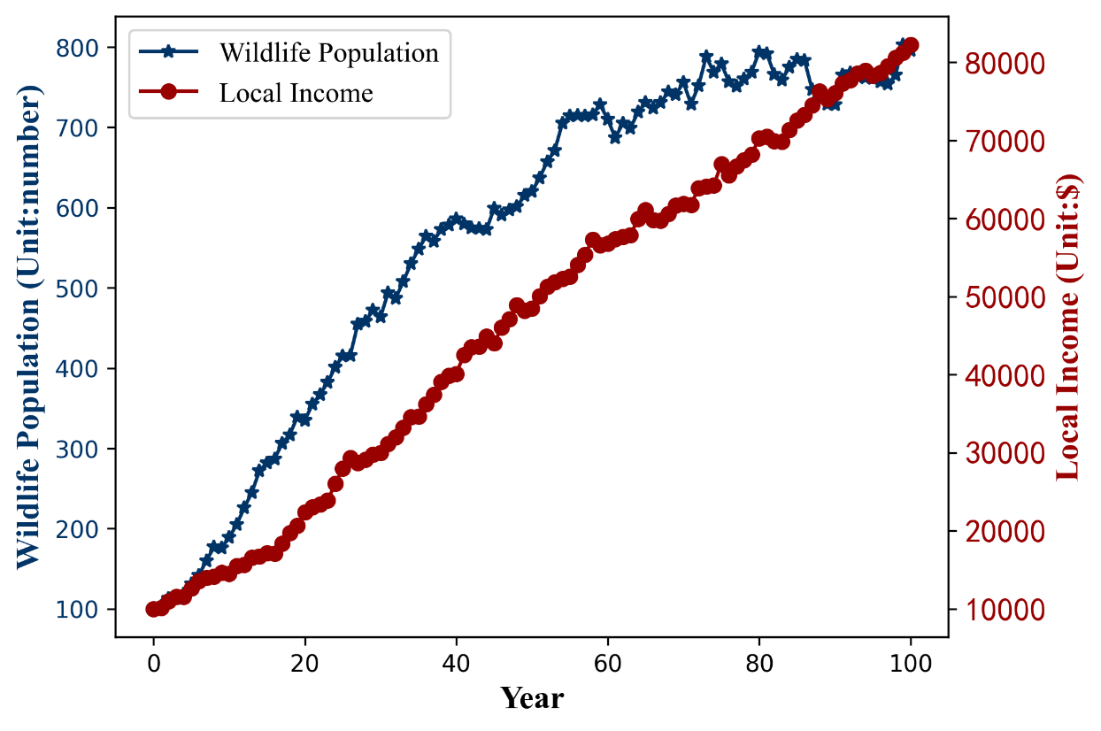
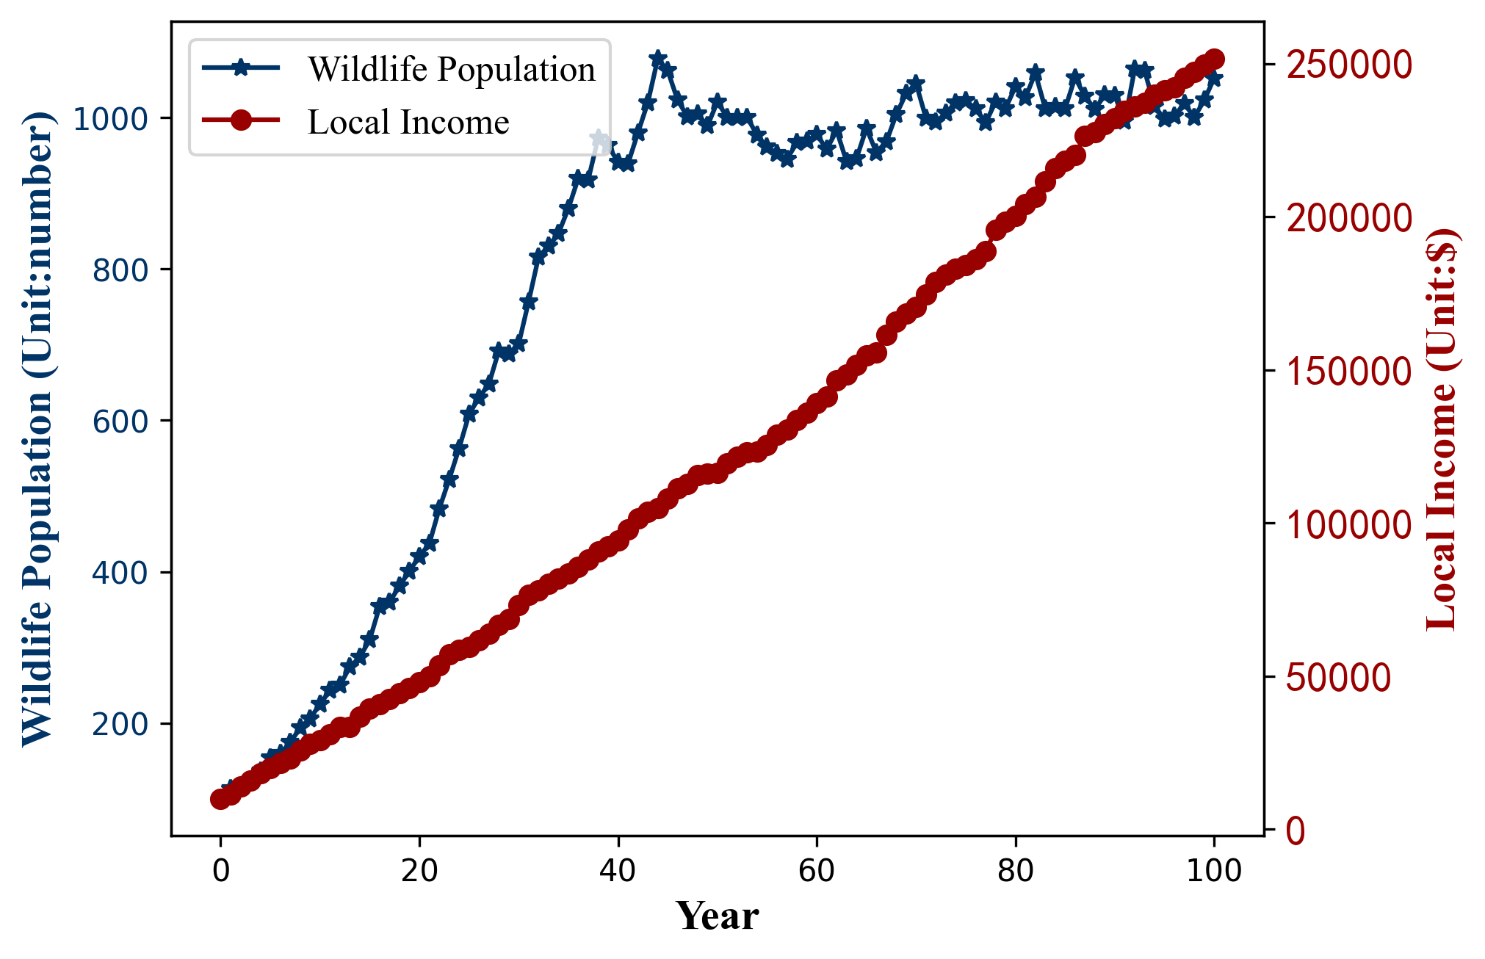
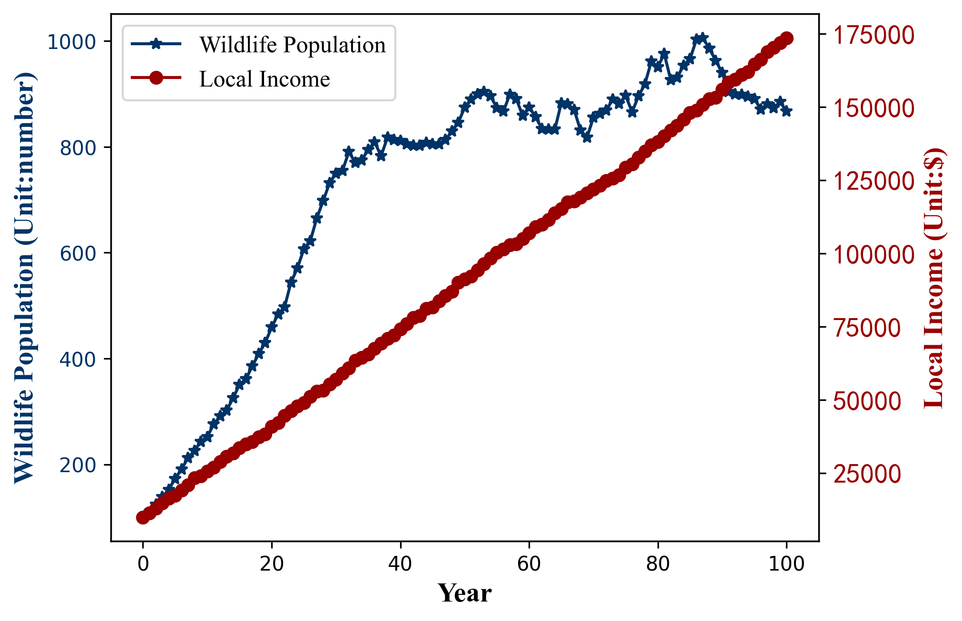
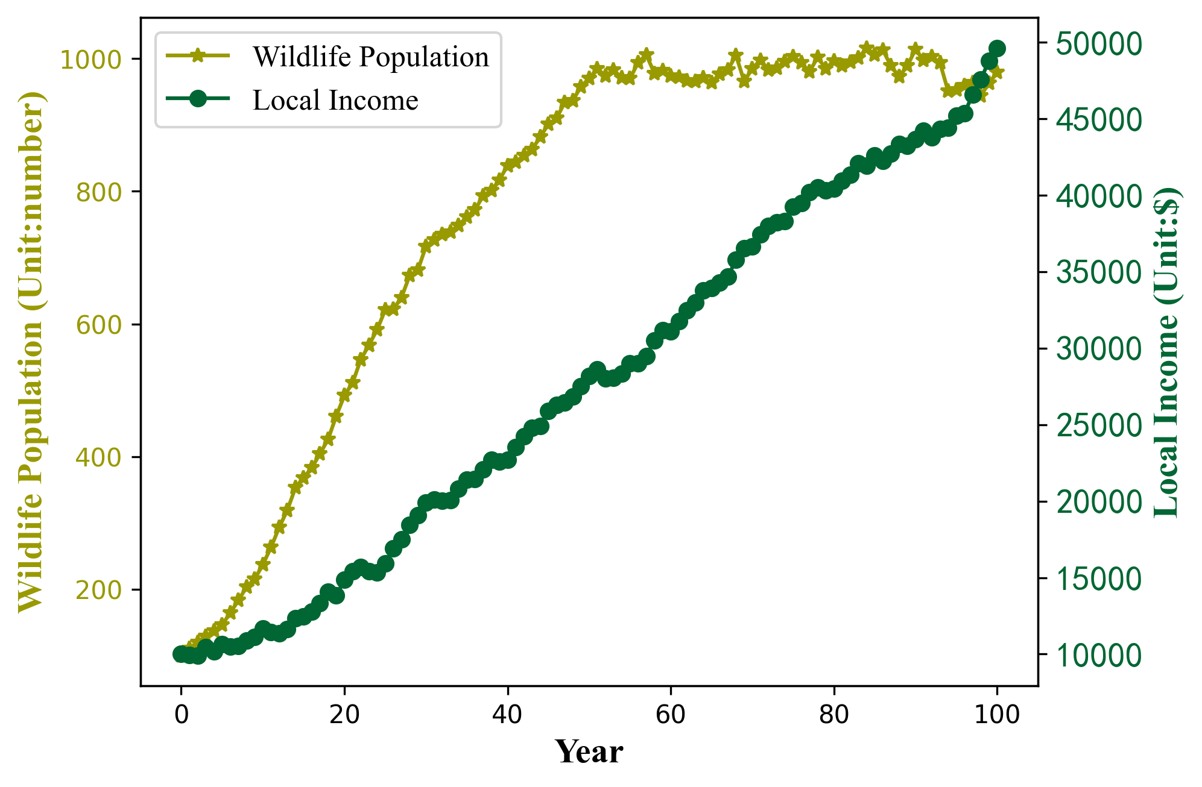
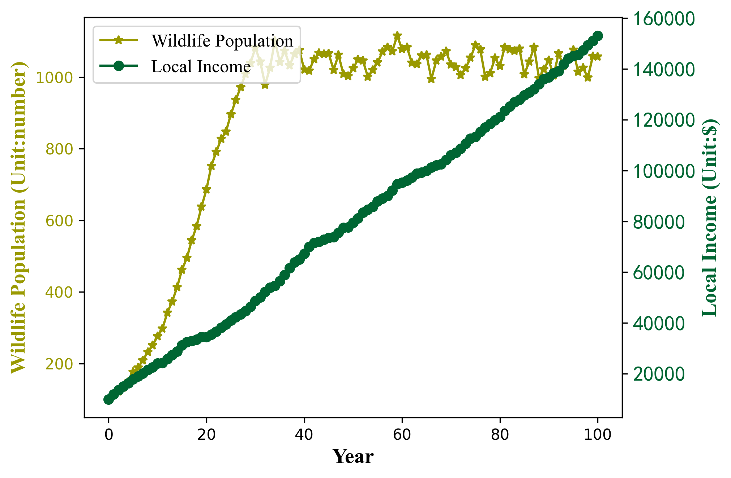
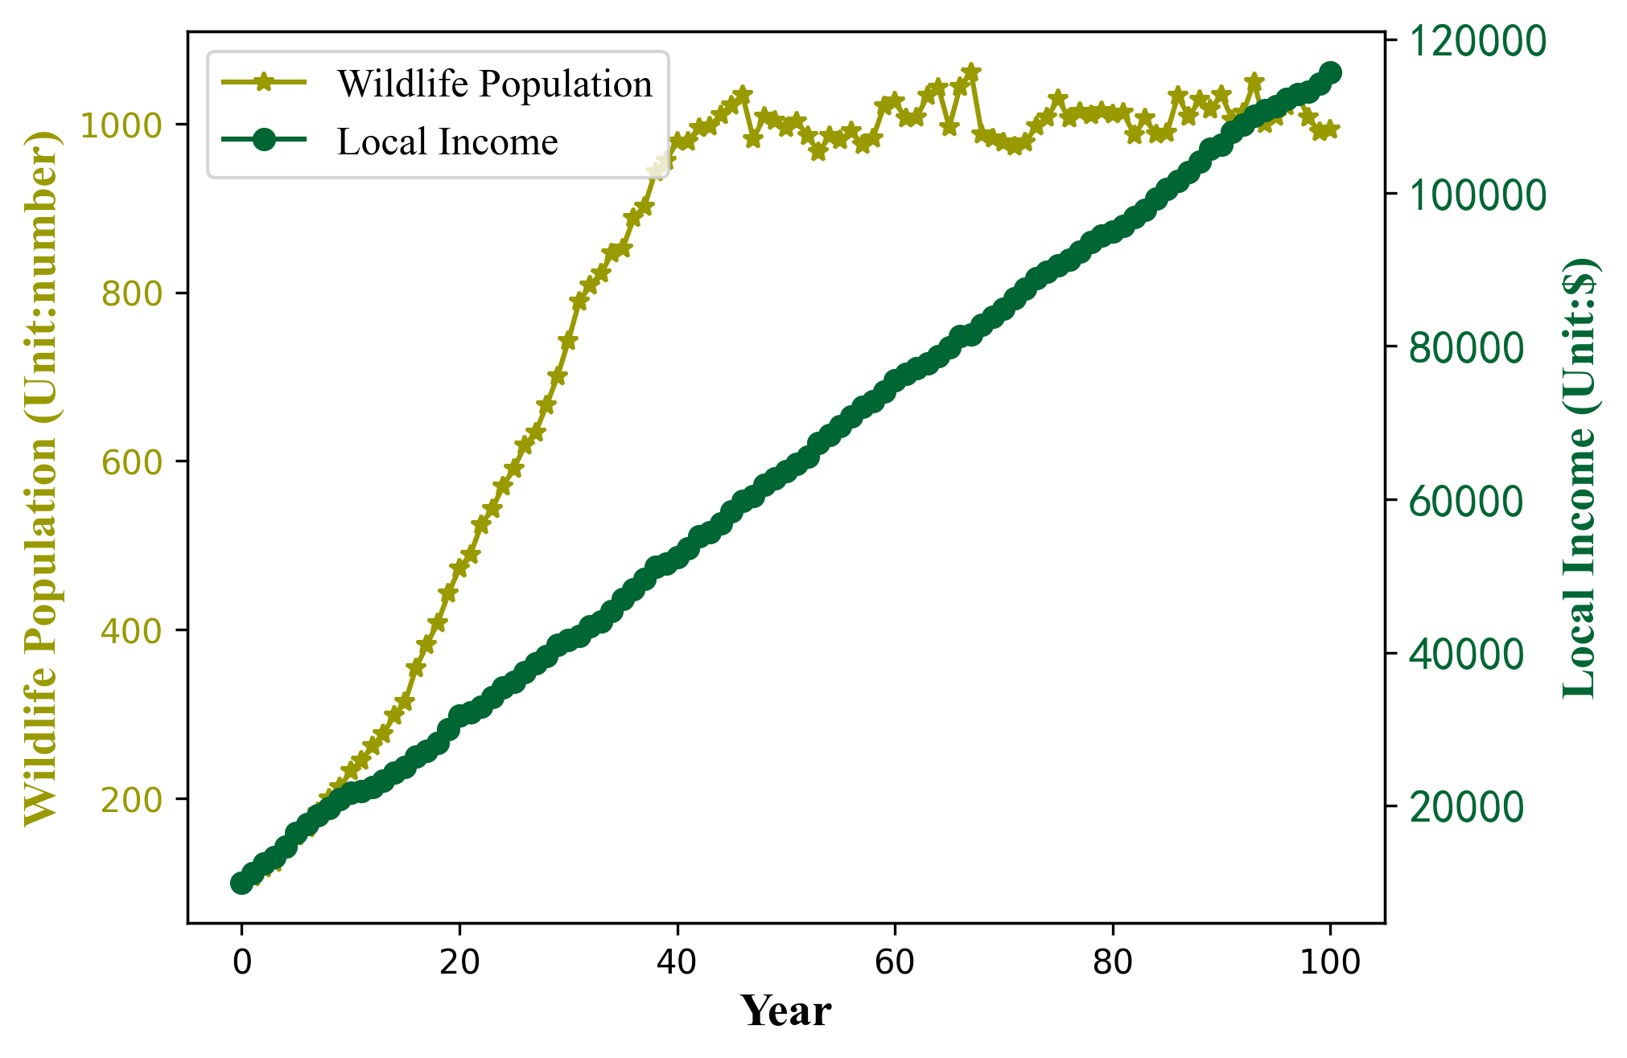
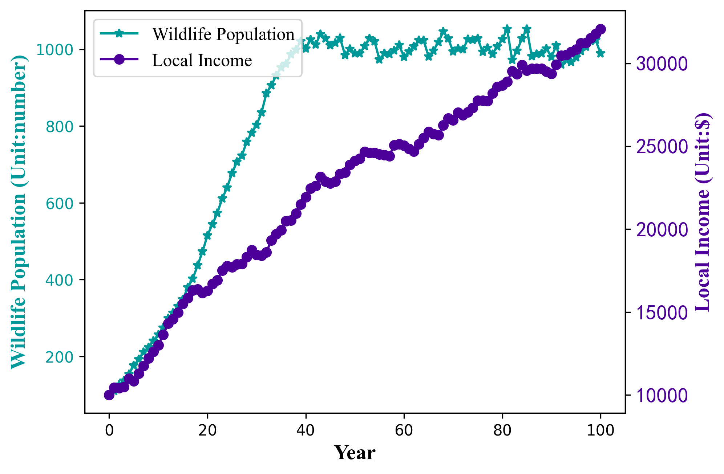
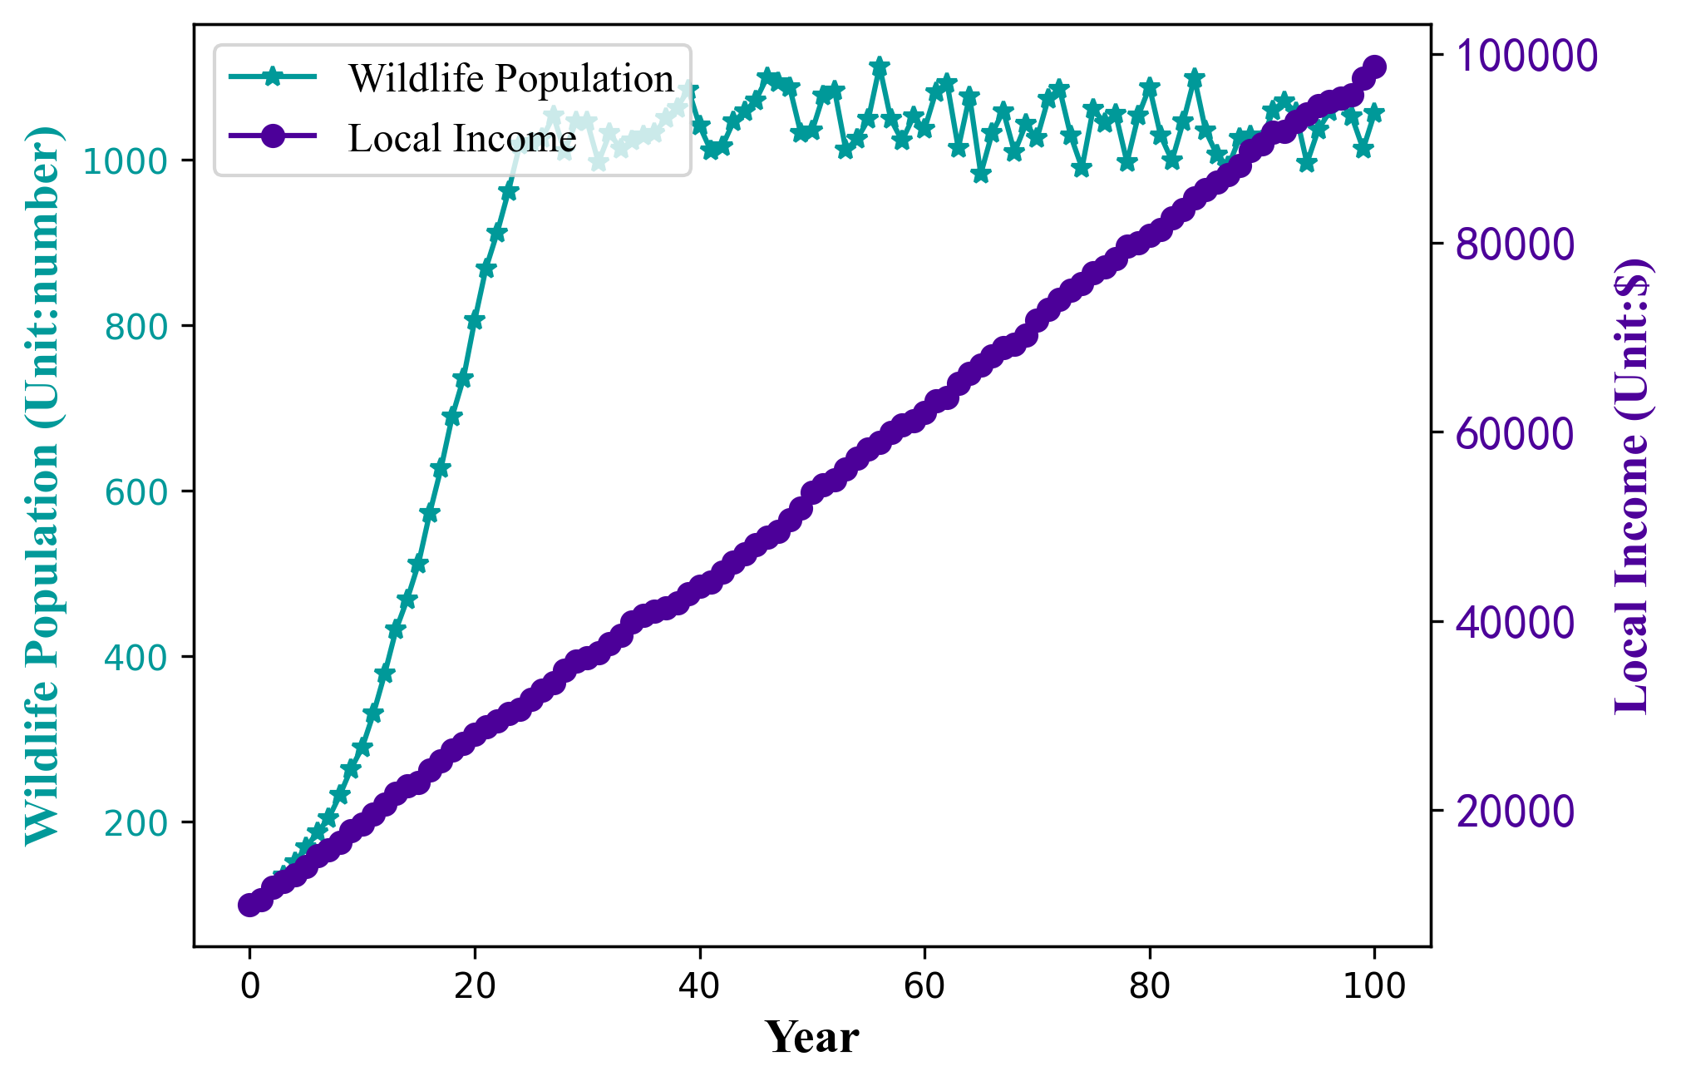
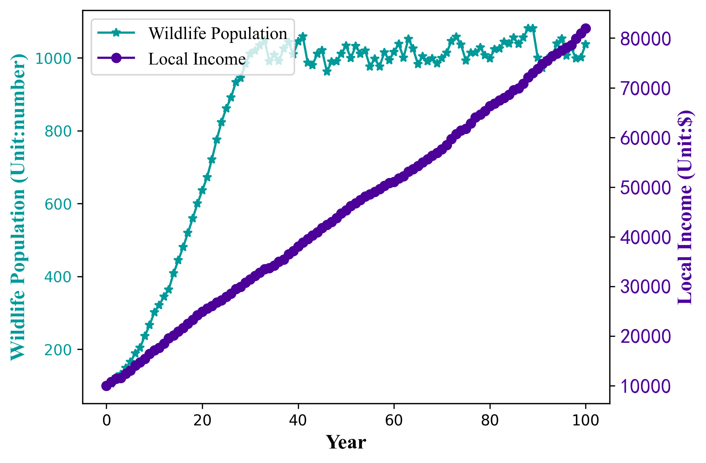
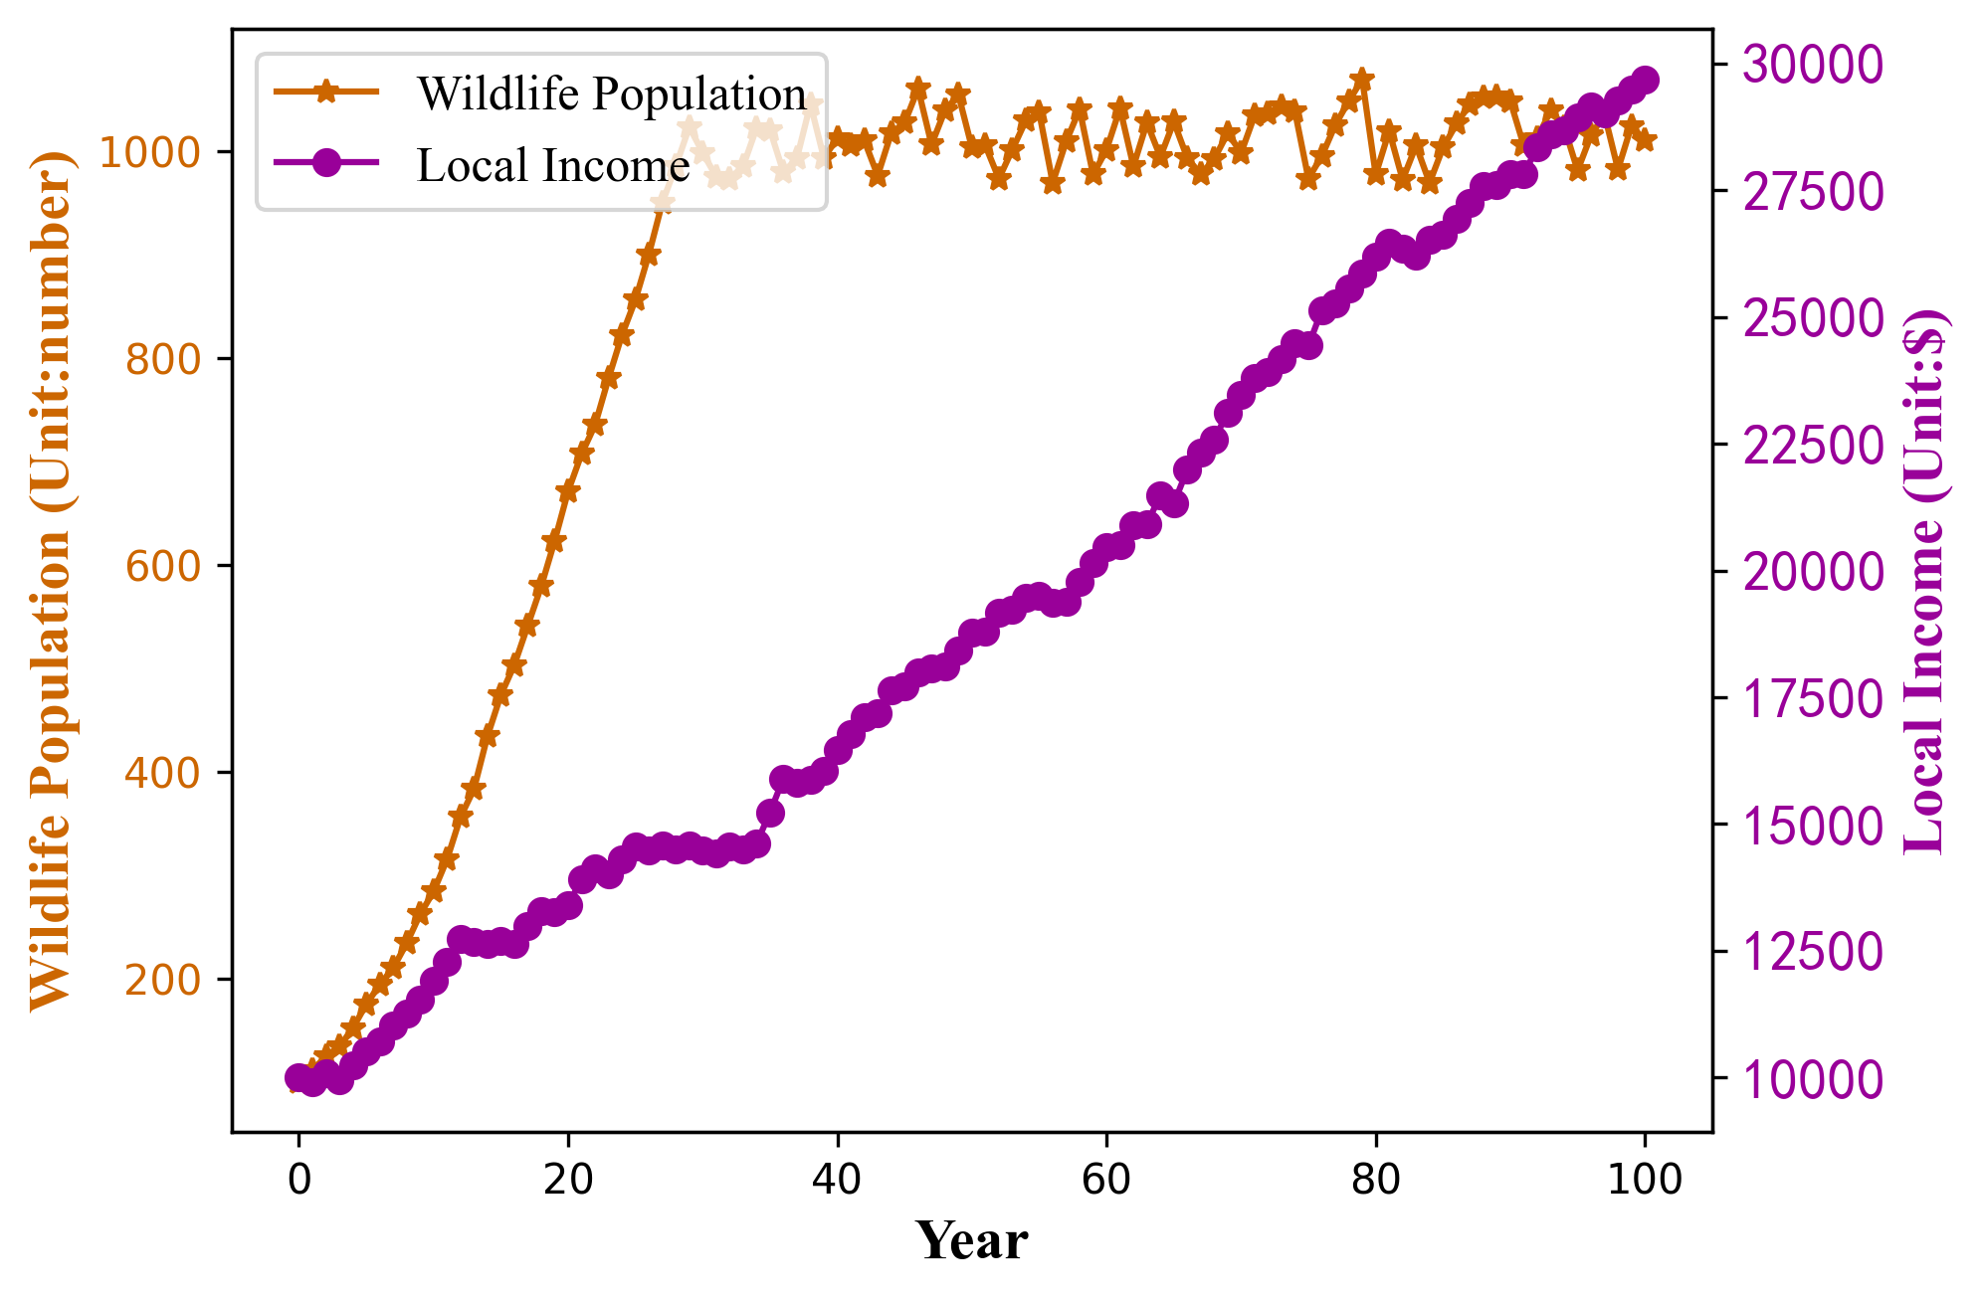
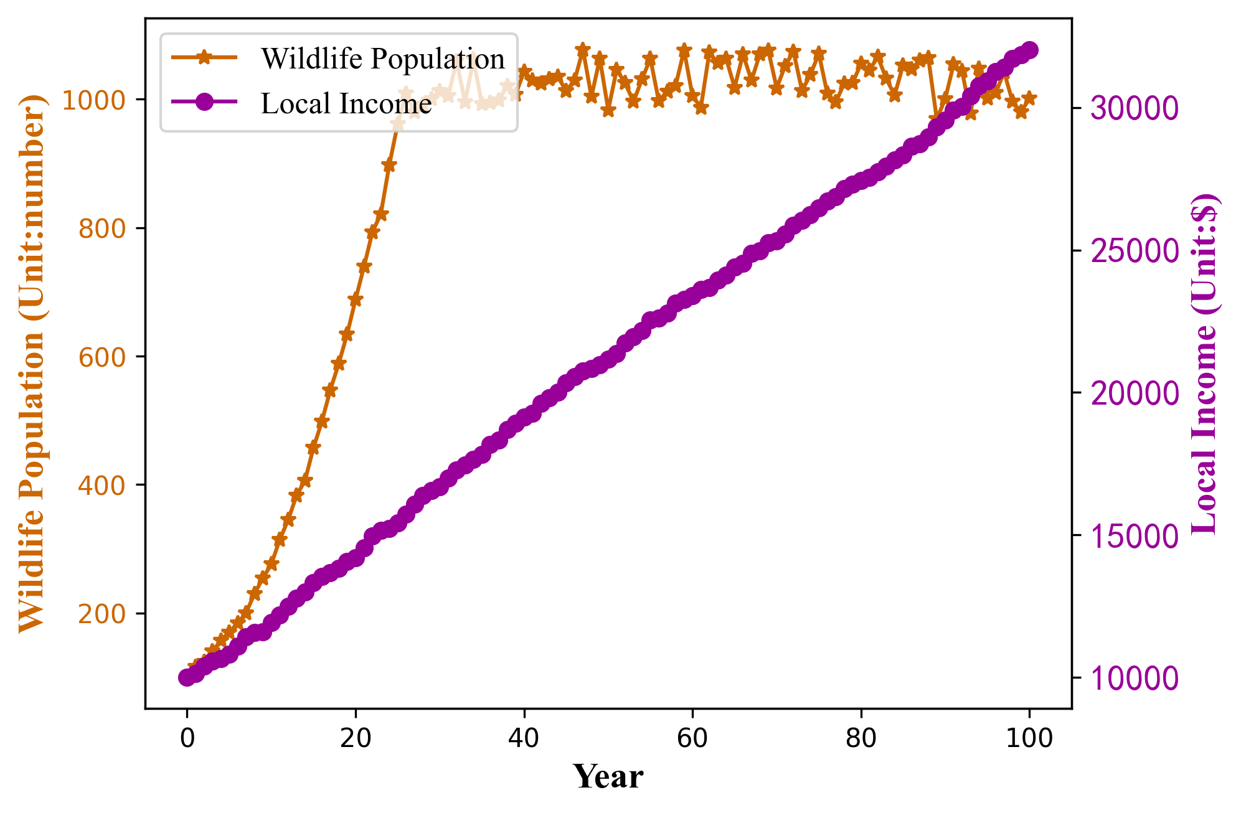
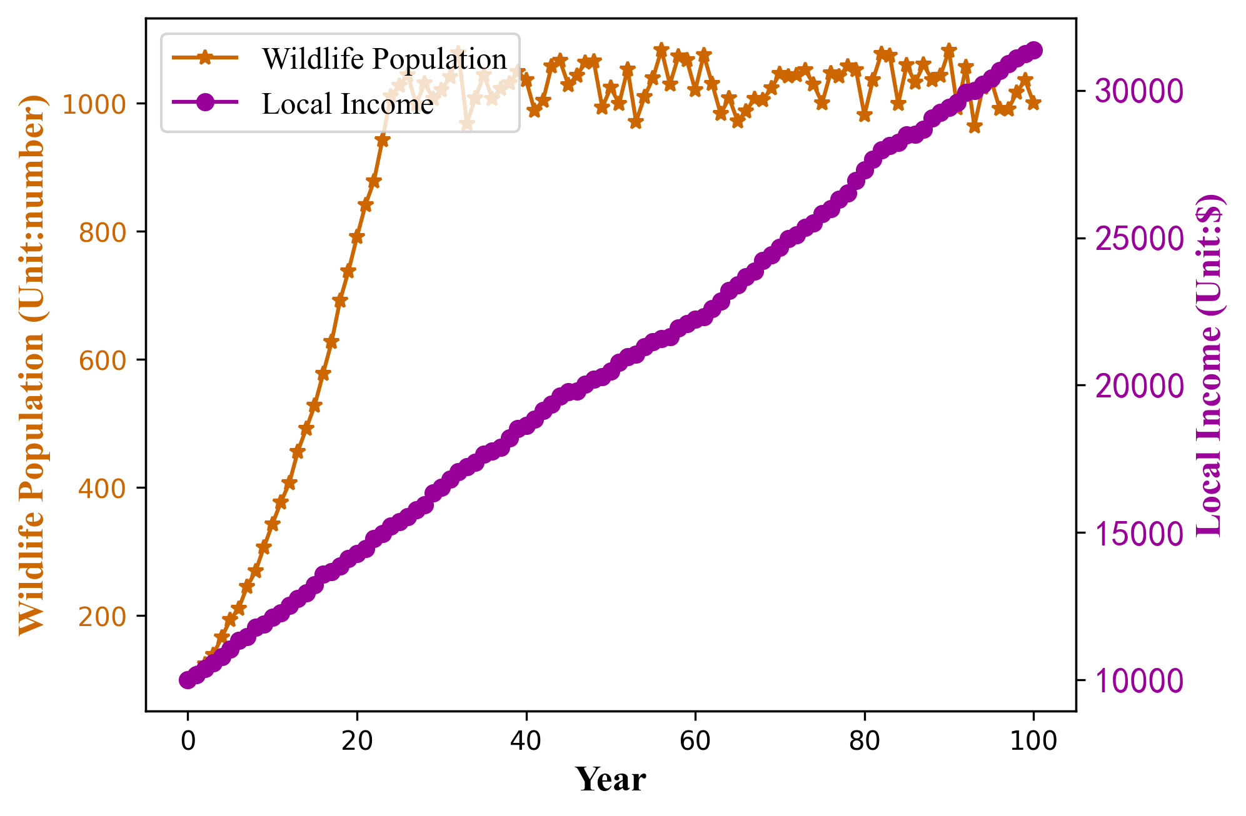
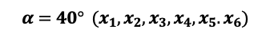
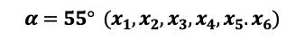




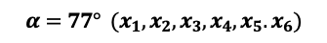
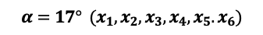




Figure 9(*12)
$$α=17° (x_{1},x_{2},x_{3})$$
$$α=17° (x_{1},x_{2},x_{3},x_{4},x_{5}.x_{6})$$
$$α=17° (x_{4},x_{5},x_{6})$$
$$α=40° (x_{1},x_{2},x_{3})$$
$$α=40° (x_{1},x_{2},x_{3},x_{4},x_{5}.x_{6})$$
$$α=40° (x_{4},x_{5},x_{6})$$
$$α=55° (x_{1},x_{2},x_{3})$$
$$α=55° (x_{1},x_{2},x_{3},x_{4},x_{5}.x_{6})$$
$$α=55° (x_{4},x_{5},x_{6})$$
$$α=77° (x_{1},x_{2},x_{3})$$
$$α=77° (x_{1},x_{2},x_{3},x_{4},x_{5}.x_{6})$$
$$α=77° (x_{4},x_{5},x_{6})$$

